Slide 1
Turning customer churn into retention
Presented by DEEKSHA BK
Newton School - 2026
Notes:
Open with the headline: one in five customers has left. This deck shows who they are, where the value is at risk, and what the bank should do about it. Every number comes from the SQL and Power BI analysis in the project report.

Slide 2
The brief: understand churn and improve retention
Clean & model
7 linked tables, 10,000 customers, prepared in Excel and Power BI
1
What the bank wants
Reduce customer churn
Improve service delivery
Raise customer satisfaction
Query
SQL in MySQL for objective and subjective questions
2
Visualise
Interactive Power BI dashboard with slicers
Customers segmented by geography, gender, age, products and activity to find who is at risk.
3
Recommend
Insights and actions for each finding
4
Notes:
Set context in about a minute: the bank wants less churn, better service and happier customers. The method: clean, query, visualise, recommend.

Slide 3
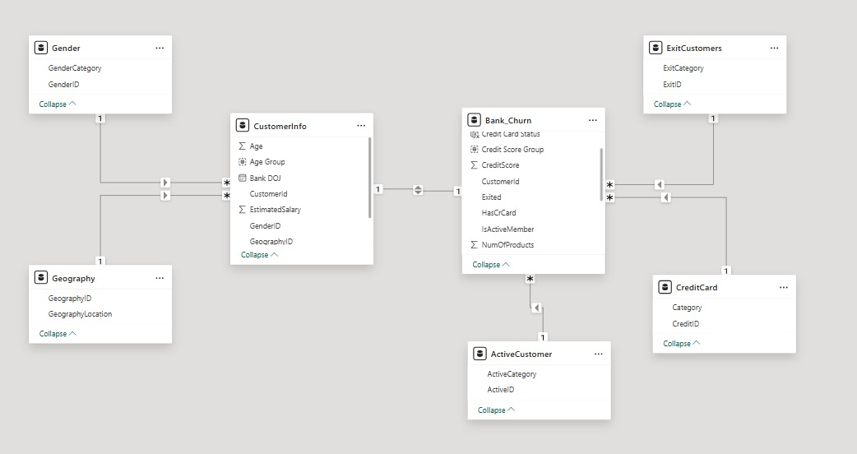
Data model: two core tables and five lookup tables
0 missing
no missing values in any column
735
exited customers wrongly flagged as active (36% of exits)
5,151 → 4,416
Power BI model view
active members after correction
Notes:
Two data tables (CustomerInfo, Bank_Churn) and five lookups (Gender, Geography, ExitCustomers, CreditCard, ActiveCustomer). No missing values. 735 customers have Exited = 1 but IsActiveMember = 1, which is impossible. Exited is trusted, so a corrected activity column was created. Tenure only ranges 3-7 and conflicts with join dates, so it is flagged for audit.

Slide 4
Overall churn is 20.37%: 2,037 of 10,000 customers
10K
2,037
7,963
Total customers
Exited customers
Retained customers
20.37%
650.53
76.49K
Churn rate
Avg credit score
Avg balance
Churn stays near 20% in every joining-year cohort, so growth is not improving retention.
Notes:
KPIs from the Executive Overview page. Churn by joining year: 19.27, 22.35, 20.21, 19.86 percent. The dataset has no exit date, so this is churn by cohort, not churn during each calendar year.

Slide 5
Churn is highest for 50+, Germany and women
Age is the strongest signal; Germany churns at 2x France and Spain.
Notes:
Age 50+ churns at about 45%, versus 7.6% for 18-30. Germany is roughly double France and Spain. Female customers churn about 9 points more than male customers. These are associations, not proven causes.

Slide 6
Product count is the strongest lever: 2 products retain
7.6%
churn with 2 products
27.7%
churn with 1 product
83–100%
churn with 3–4 products
Offer suitable second products, and investigate why 3–4 product customers leave.
Notes:
Customers with two products churn at 7.6 percent; one product 27.7; three 82.7; four 100. Cross-selling should follow customer needs. Customers with 3-4 products leaving almost always needs investigation (bundling or service issues). Association is not causation, so pilot first.

Slide 7
Activity retains customers; card ownership does not
Inactive members churn almost 2x as often; reward usage, not just card ownership.
Notes:
Inactive members churn at about 26.9 percent versus 14.3 for active members. Card holders churn at 20.18 percent versus 20.81 for non-holders, a negligible difference. The data has no reward participation, so reward impact cannot be measured directly.

Slide 8
Germany: high balances, but the highest churn
Higher balance does not mean loyalty: focus retention work on high-balance German customers.
Notes:
Germany has average balance around 120K, churn 32.44 percent and activity around 50 percent. Spain has activity about 53 percent and churn 16.67; France about 52 percent and 16.15. Average salaries are similar, so salary does not explain the gap. No external economic indicators are in the data. Balance values for Spain and France are read from the dashboard chart (about 62K each).

Slide 9
Credit score, salary and tenure explain little
Credit score
Salary
Tenure
Exit rate is highest below 580 (22.02%), but credit score alone separates leavers from stayers only weakly.
No correlation between salary and balance, or salary and credit score, for stayers or leavers.
Churn is about 20% at every tenure; long-term customers are not more loyal than new ones.
Segment retention offers by age, products, activity and region, not by these three.
Notes:
Credit score segment below 580 has the highest exit rate at 22.02 percent while the 580-669 segment has the most churned customers by count. Salary and balance show zero correlation. New customers average 76.6K balance and 1.56 products versus 76.3K and 1.51 for long-term customers; activity is 52.14 vs 51.03 percent.

Slide 10
New customers arrive in waves: Sep, Nov and Dec
42% of joiners start in Sep, Nov or Dec: plan onboarding and early retention offers around them.
Notes:
The same months spike every year. September, November and December account for 4,202 of 10,000 joiners; January and February are the trough. Campaign data is not in the dataset, so campaigns are only a possible explanation.

Slide 11
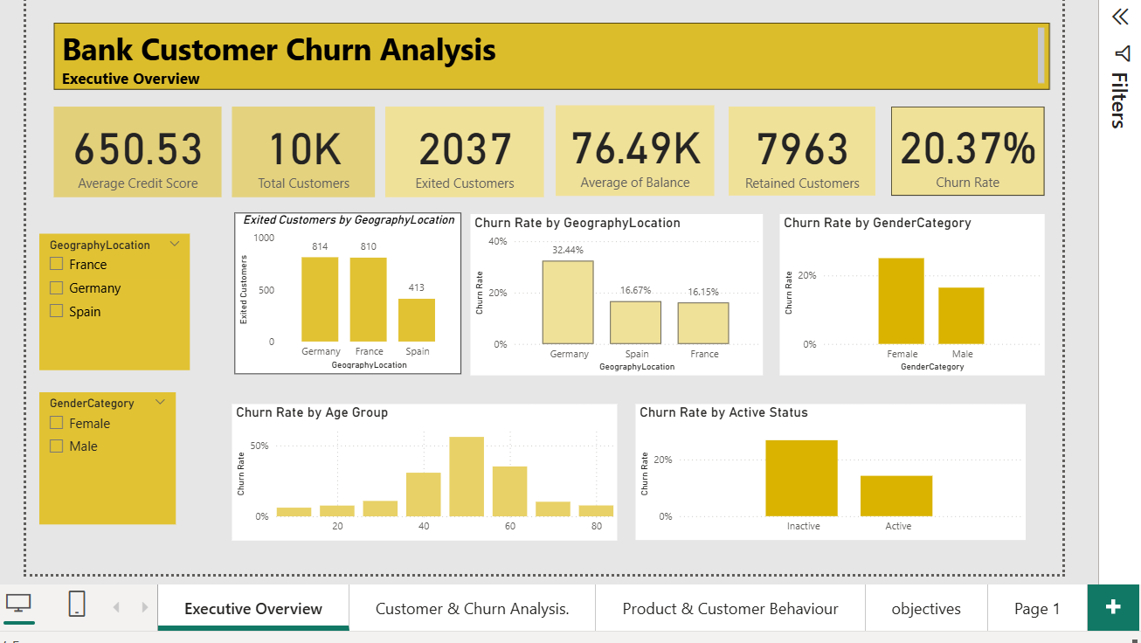
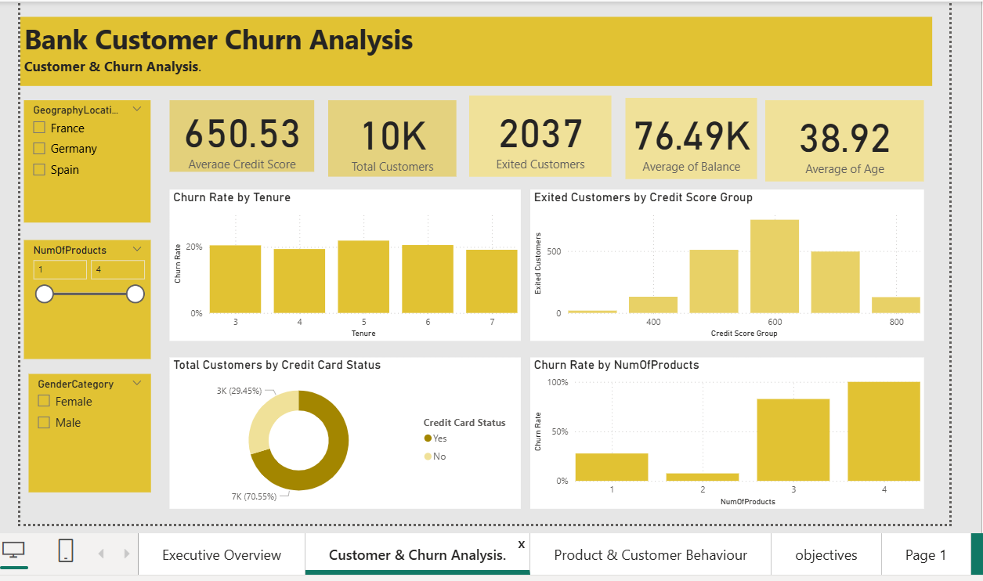
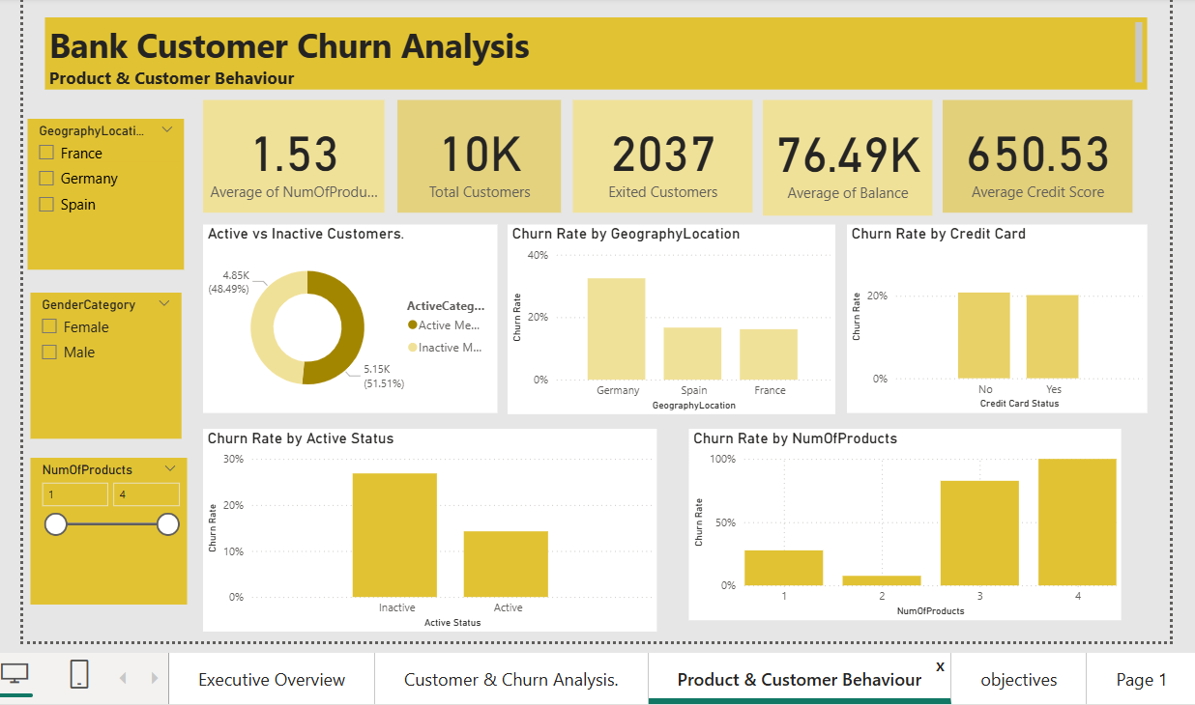
Power BI dashboard: three interactive pages
Executive Overview | Customer & Churn Analysis | Product & Customer Behaviour. Slicers: geography, gender, number of products.
Notes:
Walk through the three pages: Executive Overview for KPIs and churn by geography, gender, age and activity; Customer & Churn Analysis for tenure, credit score, products and card status; Product & Customer Behaviour for activity, geography, card and product views.

Slide 12
Recommendations
Target Germany
Engage high-balance customers with regular contact and region-specific campaigns.
Support 50+ customers
Review service accessibility and offer personalised support.
1
2
Deepen product use
Offer suitable second products; audit 3–4 product customers.
Re-activate inactive members
Usage-based rewards and follow-up with inactive customers.
3
4
Plan around the waves
Staff for Sep, Nov, Dec; run activation campaigns in Jan–Feb.
Track and pilot
Pilot with control groups; monitor churn on the live dashboard.
5
6
Notes:
Each recommendation maps to a finding: Germany, age 50+, product depth, inactivity, seasonality, and measurement through pilots.

Slide 13
Conclusion
Churn is concentrated in customers aged 50+, in Germany, with one or 3–4 products, or inactive.
Credit score, salary, tenure and card ownership are weak signals.
Retention, not just acquisition, is the lever to pull.
Data gaps to close
Exit reasons and dates, campaign records, product names and transactions would turn these patterns into confirmed causes. Tenure (3–7 years) also conflicts with join dates and should be audited.
Thank you | Questions?
Notes:
Close on three takeaways and be open about data limits: no exit reasons, no campaign data, no product names, no transactions.

